Slide 1
Implementation of Excise Stamps on Packets of Cigarettes and Alcoholic Products PRESENTED BY: Rajendra Gupta Ramnarain Section Head, Excise Section Date: 08th October 2019

Slide 2
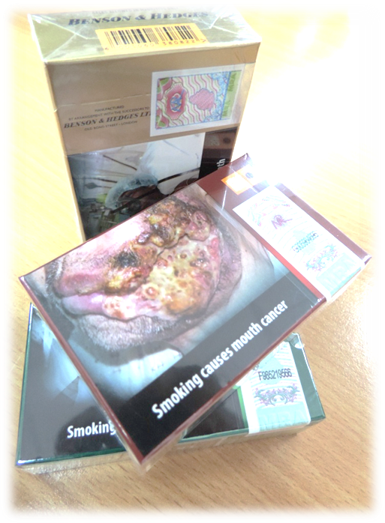
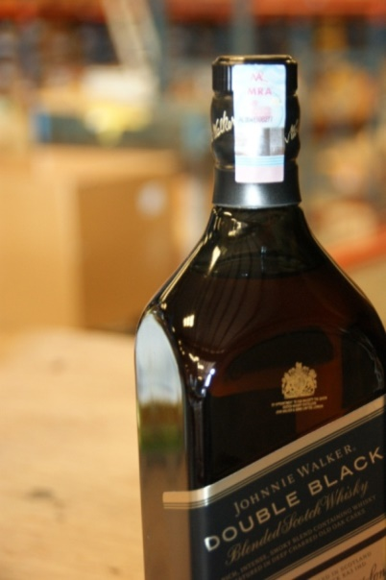
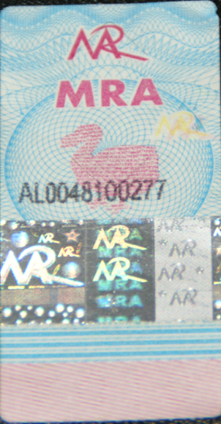
Implementation of Excise Stamps
Implementation of Excise Stamps
Cigarettes - December 2008
Alcoholic Products - October 2013

Slide 3
Reasons for introducing Excise Stamps
Reasons for introducing Excise Stamps
Combat smuggling and counterfeiting of tobacco products.
Enhance trade facilitation.
Promote legitimate trade.
Increase revenue collection.
Enhance consumer confidence.

Slide 4
Implementation of Excise Stamps
Section 99A of the Excise Regulations
For the purposes of section 25 (2) (d) of the Act, no excisable goods specified in the Twelfth Schedule shall, subject to paragraph (3), be manufactured in, or imported into, Mauritius unless the goods are affixed with an excise stamp.
The excise stamp under paragraph (1) shall be affixed in the manner specified in Column 2 of the Twelfth Schedule corresponding to the excisable goods specified in Column 1 of that Schedule.
Excise Stamps shall not apply to excisable goods where they are –
(a) intended for export;
(b) used as ship’s stores;
(c) entered into a Freeport zone under the Freeport Act 2004;
(d) intended for sale in a duty-free shop under the Customs Act;
(e) intended for sale to visitors, departing citizens of Mauritius or a master or members of a crew leaving for a foreign airport or port in a shop under the Deferred Duty and Tax Scheme under the Customs Act
(f) Imported directly by diplomatic missions, or delivered from a bonded warehouse to diplomatic missions and agents, for their exclusive use.
(g) Imported directly by any passenger under items E8 & E9 of Part II of the First Schedule to he Customs Tariff Act, provided that the goods are not intended for sale.

Slide 5
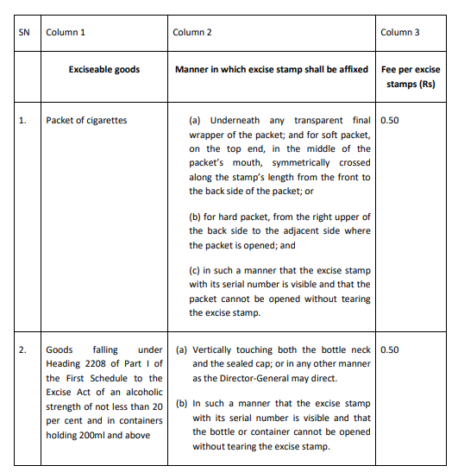
Implementation of Excise Stamps as per Twelfth Schedule

Slide 6
Implementation of Excise Stamps on Packets of Cigarettes
Purchase and affixing of Excise Stamps on Packet of Cigarettes
Excise stamps are purchased from MRA Customs in sheets or precut before importation of cigarettes.
The Excise stamps are forwarded to the manufacturer of cigarettes in the country of origin by the distributor in Mauritius.
The Excise stamps are affixed on the packets of cigarettes under the plastic layer as in the manner specified in Column 2 of the Twelfth Schedule

Slide 7
Purchase of Excise Stamps
Local Manufacturers
Fill application form (Form No. 4)
Effect Payment upon receipt of a voucher from the Excise Section
Delivery of Excise Stamps
Excise Stamps to be affixed prior to removal for Home Consumption

Slide 8
Purchase of Excise Stamps
Importers
Fill application form (Form No. 4)
Effect Payment upon receipt of a voucher from the Excise Section
Delivery of Excise Stamps
Fill form of undertaking (Form No. 5)
Upload as attached documents to Customs Declaration
Excise Stamps to be affixed within 15 days from time of clearance of the products
Return Part B of the Form No. 5 to the Excise Section within two (2) weeks from the time of clearance of the alcoholic products

Slide 9
Implementation of Excise Stamps on alcoholic products (Cont.)
Excise stamps are purchased from MRA Customs in rolls upon importation or manufacture by local excise operators.
The Excise Stamps are affixed on the alcoholic products by local manufactures before they are put to sale on the local market.
Importers of alcoholic products sign an undertaking to affix the Excise stamps within two weeks from the time of clearance of the alcoholic products (MRA/CUS/EXForm 5 – Part A).
Undertaking to affix Excise Stamps on alcoholic products
PART A
We, ……………………………………………………………………………..(company name) of ……….…………………………………………………………………… (company address) represented by the undersigned……………………... ……... (name of authorised representative) do hereby undertake to affix excise stamps within two weeks from the time of clearance of the alcoholic products* as per invoice no………………………………….dated…………
I also undertake to inform the Excise Section, MRA Customs, in writing, immediately after the affixing of stamps exercise is completed.
Signature of Authorised representative:…………………………………………………………

Slide 10
Implementation of Excise Stamps on alcoholic products (cont.)
Undertaking to affix Excise Stamps on alcoholic products
After affixing the Excise Stamps on the alcoholic products, Part B of MRA/CUS/EXForm 5 should be returned to the Excise Section.
PART B
To:
MRA
Email Address: Excise.Customs@mra.mu
Subject: Affixing of excise stamps on excisable goods under item 2 of the twelfth schedule
This is to inform you that We,………………………………………………… (company name) of ……….…………………………………………………………………… (company address) represented by the undersigned……………………... …… (name of authorised representative) have duly affixed excise stamps on the consignment of alcoholic products imported as per customs declaration no………………………………………………………..dated………………
Signature of Authorised representative:…………………………………………………………

Slide 11
Implementation of Excise Stamps on alcoholic products (cont.)
Implementation of Excise Stamps on Alcoholic Products
Goods under HS Code 2208
Excise stamps on goods of alcoholic strength of not less than 20 per cent and in containers holding 200ml above : Whisky, Cognac, Brandy, Rum, Gin, Vodka, Liqueurs, Cordial, Tequilla and compounded/ad mixed spirits
Application form for purchase of Excise Stamps (MRA/CUS/EX/Form 4) to be filled by importer
Form of undertaking (Form No. 5 – Part A) to be filled by importer - Undertaking from Importers for affixing of excise stamps on excisable goods under item 2 of the twelfth schedule
Payment receipts for purchase of Excise Stamps to be submitted
All above documents to be uploaded as attached documents to Customs Declaration

Slide 12
Implementation of Excise Stamps on alcoholic products
Budget Speech Tax Administration
Presently, it is mandatory to affix tax stamps on bottles of spirits, such as whisky and rum of an alcoholic strength of not less than 20 per cent and in containers holding 200ml and above.
This obligation will be extended to all alcoholic products in containers holding 50ml and above, including beer and wine.
Regulations on affixing excise stamps on alcoholic products of more than 50 ml, wine and beer shall come into operation on 03 February 2020.

Slide 13
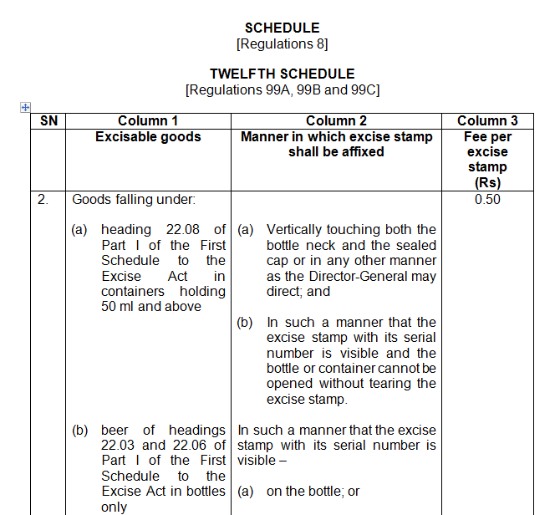
Twelfth Schedule

Slide 14
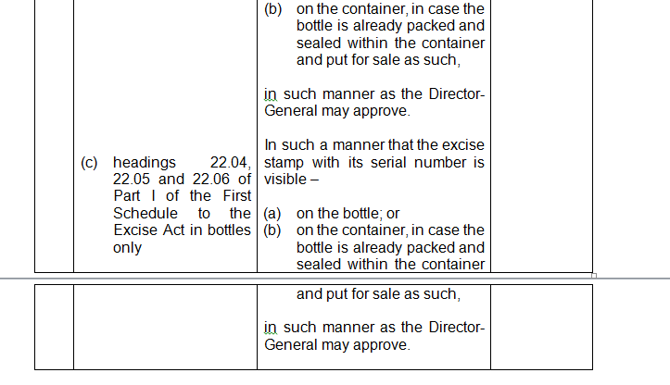
Twelfth Schedule (cntd)

Slide 15
Specifications of Excise Stamps
The manufacturer of these excisable products should have the machine and equipment for affixing these excise stamps as per the above specifications with respect to the dimension.
The excise stamps for alcoholic products differ from that of wine and beer in terms of material used for the manufacture of the excise stamps as beer and wine are basically consumed chilled.

Slide 16
Specifications of Excise Stamps
ACTUAL - ALCOHOLIC PRODUCTS
PROPOSED - WINE AND BEER
18mm
15mm
40mm
40mm

Slide 17
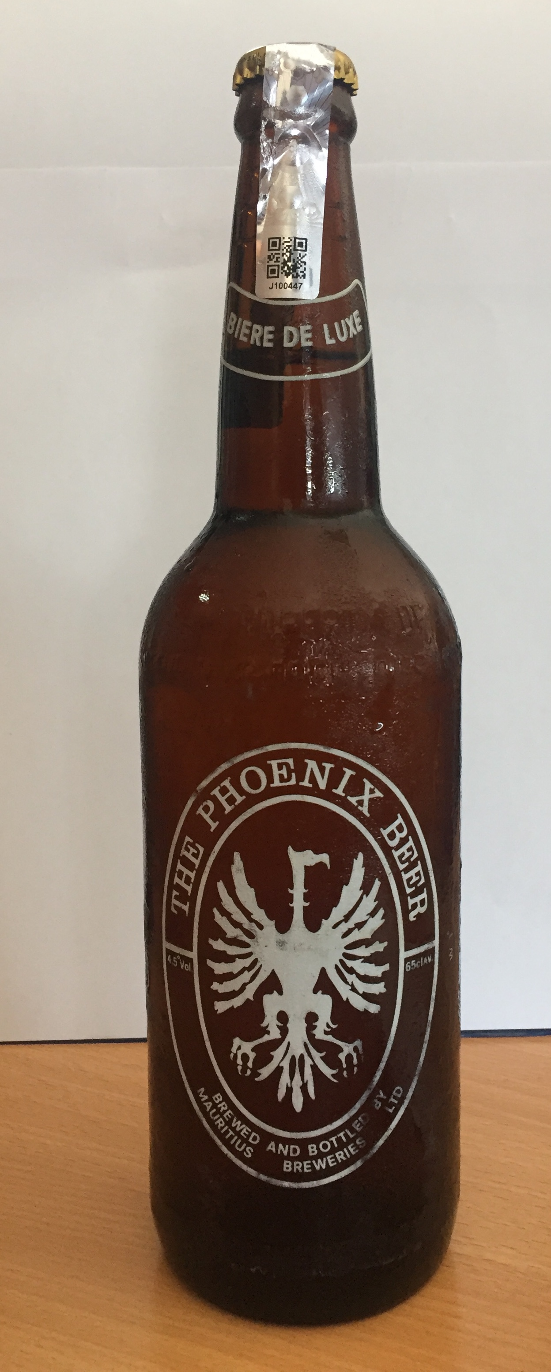
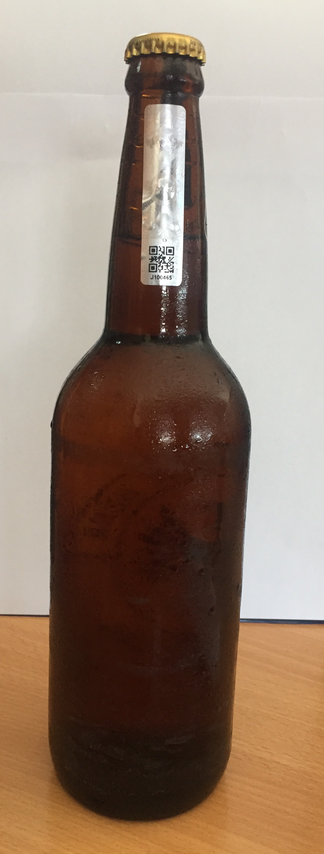
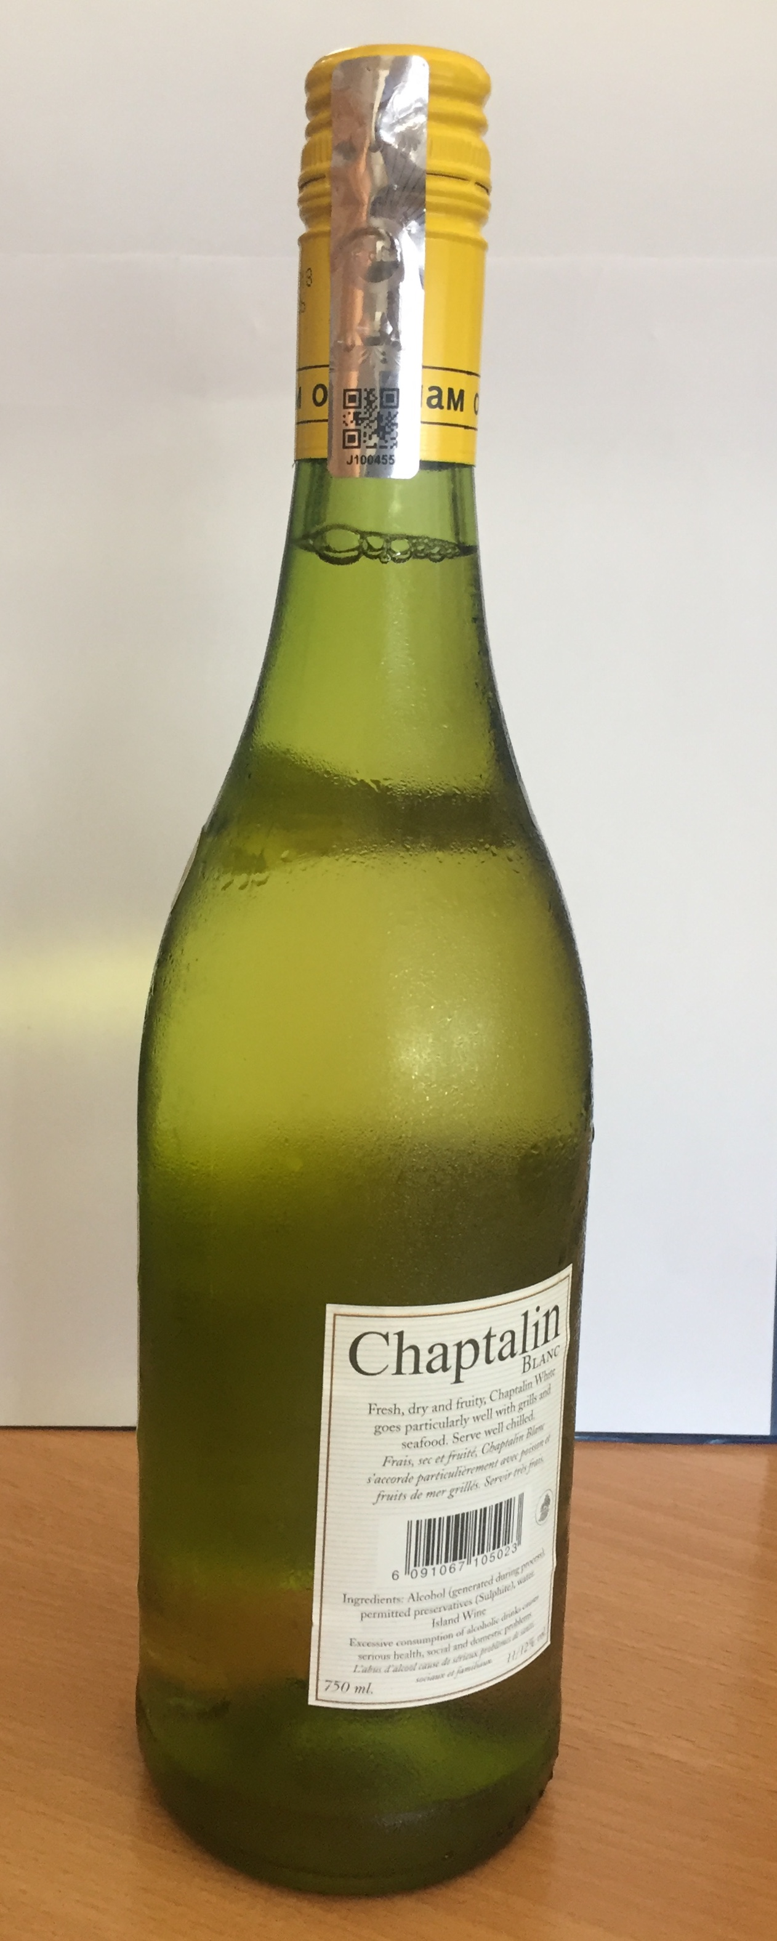
Excise Stamps on Beer and Wine
The following bottles have been used as samples for affixing excise stamps and are refrigerated since October 2018

Slide 18
Application of Excise Stamps
Spirits
Spirits of an alcoholic strength of not less than 0.5 per cent and in containers holding above 50 ml.
Wine
Includes all types of wine manufactured locally or imported (excluding Bricks and Cans).
Beer
Bottles of any capacity (excluding Cans, Kegs, Bricks and any other similar container).

Slide 19
Alternative Markings
S25(2)(e) of the Excise Act:
The Director-General may, for the purpose of exercising control over excisable goods –
(e) require a licensee or an importer to put markings as an alternative to excise stamps on such prescribed excisable goods and in such form and manner and on such conditions as the Director-General may determine.

Slide 20
Alternative Markings
Regulation 99DA
(1) For the purpose of section 25(2)(e) of the Act, no excisable goods specified in the Fourteenth Schedule may be manufactured in, or imported into, Mauritius unless the goods bear markings as an alternative to the excise stamps in such form, manner and conditions as the Director-General may determine.
(2) Subject to regulation 99B(1), no person shall, in the course of his business, sell or otherwise transfer excisable goods specified in the Fourteenth Schedule unless the goods bear marking in accordance with paragraph (1).
(3) Notwithstanding paragraph (1), any person who, on 2 February 2020, has, in the course of his business –
a stock of imported or locally manufactured goods;
(b) goods in a bonded warehouse or Freeport zone,
falling under the Fourteenth Schedule, shall, not later than 2 August 2020, sell or otherwise transfer or remove for home consumption, as the case may be, the goods without causing the goods to be marked with the markings.

Slide 21
FOURTEENTH SCHEDULE
[Regulation 99DA]
ALTERNATIVE MARKINGS ON EXCISABLE GOODS
1. Cigarettes of H.S. Codes 2402.20.00 and 2402.90.90
2. Goods falling under Heading 22.08 of Part I of the First Schedule to the Excise Act
3. Beer of Headings 22.03 and 22.06 of Part I of the First Schedule to the Excise Act
4. Goods falling under Headings 22.04, 22.05 and 22.06 of Part I of the First Schedule to the Excise Act
Currently Alternative marking is applicable on locally manufactured beer.

Slide 22
Management of Excise Stamps
Management of Excise Stamps
Excise Stamps are purchased from the MRA at 50c per unit by :
-Local Manufacturers
-Importer of Cigarettes
-Registered and licensed importers of alcoholic products
-Occasional importers
Monthly Returns
All purchasers of excise stamps are required to submit a monthly return of the number of stamps purchased, used, damaged and in stock at their premises.
Reconciliation of Excise Stamps
Physical quantity of excise stamps remaining is reconciled with quantity purchased and used (including damaged stamps).

Slide 23
Management of Excise Stamps
Regulation 99C
(4) Any excise stamp spoiled or damaged shall be returned to the Director-General by the manufacturer or importer.
(5) (a) The Director-General shall cause a stocktaking to be made every calendar quarter in respect of –
(i) excise stamps used by a manufacturer or an importer;
(ii) excise stamps spoiled or damaged in the process of affixing the excise stamps and returned to the Director-General; and
(iii) excise stamps accounted as spoiled or damaged by a manufacturer or an importer, but not returned to the Director-General.

Slide 24
Management of Excise Stamps
(b) Any excise stamp accounted as spoiled or damaged by the manufacturer or importer, but not returned to the Director-General, shall be deemed to have been used and shall attract –
(i) in respect of beer of Headings 22.03 and 22.06, duty, excise duty and taxes based on the highest rate applicable to such excisable goods cleared for home consumption during the last 4 calendar quarters by reference to their strength, volume and value;
(ii) in respect of wine of Headings 22.04, 22.05 and 22.06, duty, excise duty and taxes based on the highest rate applicable to such excisable goods cleared for home consumption during the last 4 calendar quarters by reference to their strength, volume and value;

Slide 25
Management of Excise Stamps
(iii) in respect of goods of Heading 22.08, duty, excise duty and taxes based on the highest rate applicable to such excisable goods cleared or removed for home consumption during the last 4 calendar quarters by reference to their alcoholic strength, volume and value; or
(iv) in respect of cigarettes, duty, excise duty and taxes based on the highest rate applicable to such excisable goods cleared for home consumption during the last 4 calendar quarters by reference to their quantity and value.

Slide 26
Management of Excise Stamps
The Director-General may, in computing the duty, excise duty and taxes under subparagraph (c), give an allowance of up to one per cent of the quantity of excise stamps used by a manufacturer or an importer in respect of the last 4 calendar quarters.
For the purpose of sub subparagraph (i), the allowance shall be applied on product basis referred to in subparagraph (b).

Slide 27
Contact Person : SH R. G. RAMNARAIN
Tel : 202 0500 (Ext. 7400)
Email: rajgupta.ramnarain@mra.mu
excise.customs@mra.mu
customs@mra.mu

