Slide 1
MRA Deferred Payment Scheme
& Web Based Customs Declarations
Presented by
Rajendra Gupta Ramnarain
Section Head, Customs
05 August 2015

Slide 2
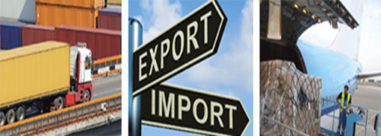
Outline
Policy decision
Benefits of the scheme
Legislation
Provision of security
Payment of duties & taxes
Default on Payment
Application procedures
Web based customs declarations

Slide 3
Policy decision
Announced by the Government in the Budget 2015
Aims to provide a more conducive business environment and further facilitate trade in Mauritius.
The scheme enables SMEs and VAT registered persons to defer the payment of the duty, excise duty and taxes on the goods cleared at importation.
The eligible operators are:
An SME registered under the SMEDA Act
VAT registered person under the VAT Act.

Slide 4
Benefits of the scheme
Importers opting for the scheme will be able to clear goods without paying duty and taxes at time of clearance.
The scheme will allow Customs to accelerate the clearance of goods as it does not require payment to be made prior to initiation of clearance procedures.
With this scheme, importers can settle a month's charges with a single payment.

Slide 5
Legislation- deferment period
Section 9A, Customs Act 1988
(1A) (a) Where goods are entered and cleared by an SME or a VAT registered person, the duty, excise duty and taxes on the goods cleared shall be paid –
in the month of June, not later than 2 working days before the end of that month; and
in any other month, not later than 7 working days after the end of that month

Slide 6
Legislation- conditions
Section 9A, Customs Act 1988 further provides that:
Provision of security: “……the SME or VAT registered person gives a security, by bond, under sections 39 and 42, to cover the deferred payment…”
Compliance with revenue laws: “….the SME or VAT registered person is in compliance with the Revenue Law under the Mauritius Revenue Authority Act”.
Eligible importers can opt for the deferred payment facility voluntarily but will qualify for it only if they are compliant with the above.

Slide 7
Provision of security
At time of registration for the scheme, importers have to:
indicate the amount of duty, excise duty and charges that they wish to defer during the month, and
submit a security by bond for 2 times that amount.
The security will be valid for the whole year and has to be renewed after its expiry.
Customs can revise the amount of security based on the duty, excise and charges deferred during the preceding year.
Notes:
Deferment Limit
If traders exceed the amount specified in their security, they will be required to submit a fresh security to cover the duty and taxes involved. The previous security will be repealed and the new one will be applied and will be valid for a period of one year.
In case the trader fails to submit a new security, his/her deferment facility may be terminated. As a precautionary measure, traders have to set the amount for the security at a maximum amount that is sufficient to cover all deferred charges that are likely to occur in any given month.

Slide 8
Payment of duties & taxes
Customs will broadcast reminders for payment of duty and taxes deferred under this scheme in the declarant’s Front-End-System on the 2nd and 5th working day.
Payment can be made by cash, cheque or simply by using the convenience of electronic payment
A single payment for several importations during the month

Slide 9
Default on Payment
In case payment is not received by the due date:
MRA will notify the importer in writing and interest at the rate of 0.5% per month or part of the month shall be applicable.
In the event of non-payment of a direct debit:
The trader’s security can be realized and the deferment facility may be suspended or stopped.

Slide 10
Application procedures
Fill in Application form:
“Application for registration under the Deferred Payment Scheme” (MRA/CUS/TFCC/REG/DPS)
Available on MRA website
Supporting documents required:
SME/VAT Registration Certificate
Certificate of Incorporation (for companies)
Director’s Certificate issued by Registrar of Companies.
Submit to TFCC, Custom House

Slide 11
Prior registration as importer
Applicants who are not registered as importer at MRA:
Fill in application form (MRA/CUS/TFCC/REG/EO + EO01)
Available on the MRA website
Documents required for registration:
Business Registration Card
TAN/VAT Certificate
NIC of applicant/ representative in case of company
Invoice
Bill of lading

Slide 12
Further information
Contact: Registration Unit, Trade Facilitation and Customs Cooperation (TFCC) Section
Custom House, Mer Rouge, Port-Louis
Tel: 2020500 (Ext.2202)
Fax: 2167784
Email: registration.customs@mra.mu
Or visit: Mauritius Revenue Authority website at www.mra.mu

Slide 13
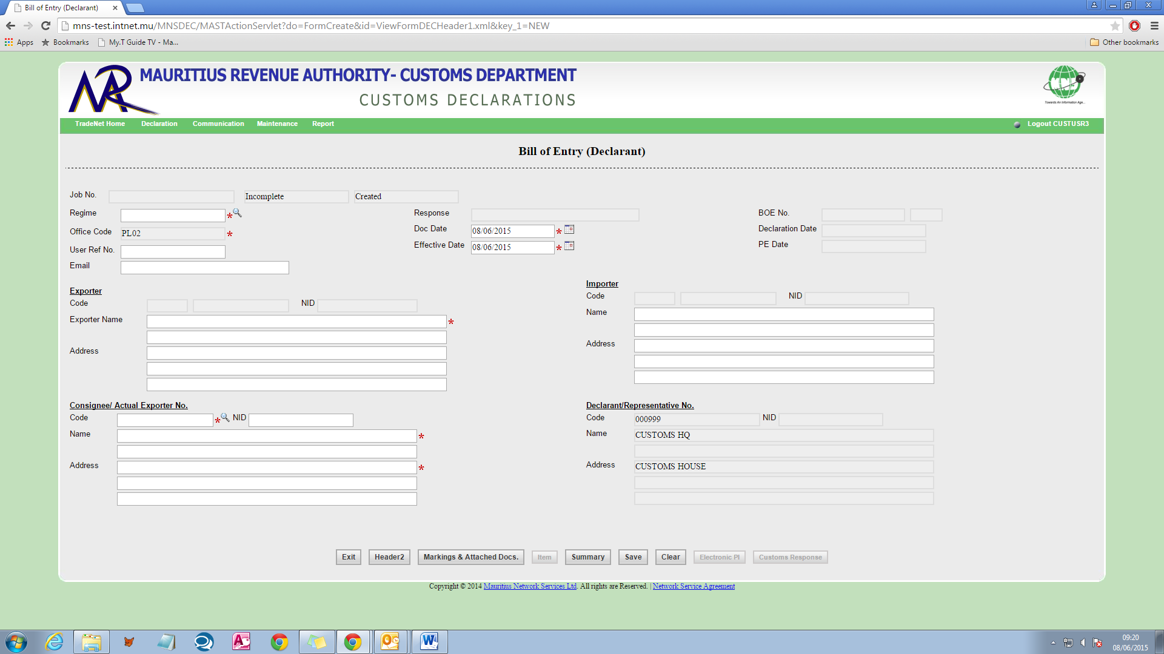
Web based Customs Declaration
A web application hosted on the MNS web portal
Accessible from anywhere
Used to prepare & send declarations to Customs
Screens similar to FES but underlying technology different
Simple and user-friendly

Slide 14
Benefits to stakeholders
Convenient and flexible
send Customs declaration from anywhere and at anytime
At your leisure and comfort
Reduced costs
Maintenance fee
Dedicated communication links
Transport, Opportunity, etc.
Hardware / platform independent
No compatibility issues
Enhanced interoperability
Accessible from a range of devices
PCs, Laptops, Tablets

Slide 15
Benefits to stakeholders
Easy and automatic updates by MNS
No need to download.
Currency rate, budget measures etc.
Secure environment
Data encrypted
No installations & configurations overhead
No back up hassle
Scalable
Easy to add more functionalities to the system

Slide 16
E-mail: Rajgupta.Ramnarain@mra.mu
Tel: +230 202 0500
Fax: +230 216 7601
Website: www.mra.mu

