Slide 1
Implementation of Excise Stamps on Alcoholic Products including Wine and Beer
PRESENTED BY :
Excise Section
Date : 16th January 2020

Slide 2
Budget Speech 2018-2019
Tax Administration: Excise
Presently, it is mandatory to affix tax stamps on bottles of spirits, such as whisky and rum, to combat tax evasion and smuggling.
This obligation will be extended to include bottles of beer and wine with a moratorium of six months.

Slide 3
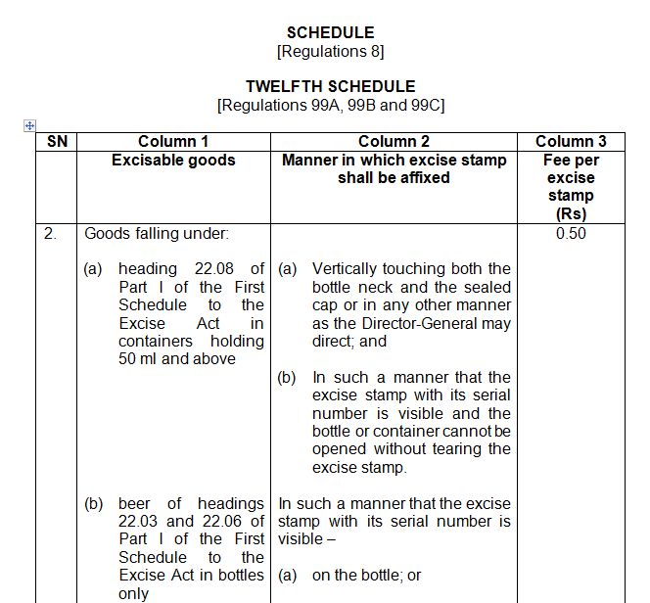
Twelfth Schedule

Slide 4
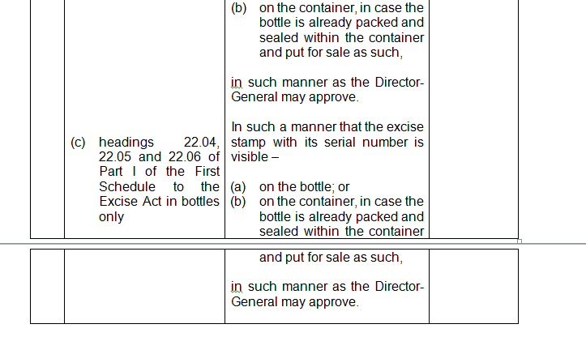
Twelfth Schedule (cntd)

Slide 5
Excise Stamps for Beer and Wine
Excise stamps for beer and wine to adapt to chilled conditions not yet procured.
Temporarily, excise stamps affixed on alcoholic products (22.08) will be used for beer and wine.
Stakeholders will be notified as soon as new excise stamps are procured.

Slide 6
Budget Speech 2019-2020
Tax Administration: Excise
Alternative Marking
Importers and manufacturers of alcohol and tobacco
products will be given the option to use digital markings as
an alternative to excise stamps.

Slide 7
GN 161 of 2019 - Regulation 99B (2)
Any person who, on 2nd February 2020, has, in the course of his business –
a stock of imported or locally manufactured goods; or
goods in a bonded warehouse or Freeport zone,
Falling under item 2 of the Twelfth Schedule with respect to Headings 22.03, 22.04, 22.05 and 22.06 and Heading 22.08 in containers holding more than 50 millilitres and less than 200 millilitres , shall, not later than 2nd August 2020, sell or otherwise transfer or remove for home consumption, as the case may be, the goods without causing the goods to be affixed with an excise stamp.

Slide 8
Remaining Stock without Excise Stamp after 2nd August 2020
Excise stamps should be affixed on any stock remaining on 3rd August 2020 prior to sale.
Excise Section will sell stamps upon request and presentation of Excise licence (Part I or Part II ).
Contact Details:
  Excise Section – Phone 202 0500 (Ext: -7407/7421)
  Email : excise.customs@mra.mu

Slide 9
GN 161 of 2019 –
Alternative Markings
Regulation 99DA
(1) For the purpose of Section 25(2)(e) of the Act, no excisable goods specified in the Fourteenth Schedule may be manufactured in, or imported into, Mauritius unless the goods bear markings as an alternative to the excise stamps in such form, manner and conditions as the Director-General may determine.
(2) No person shall, in the course of his business, sell or otherwise transfer excisable goods specified in the Fourteenth Schedule unless the goods bear marking in accordance with paragraph (1).

Slide 10
GN 161 of 2019 –
Alternative Markings ctd…
Regulation 99DA
(3) Notwithstanding paragraph (1), any person who, on 2nd February 2020, has, in the course of his business –
a stock of imported or locally manufactured goods;
goods in a bonded warehouse or Freeport zone,
falling under the Fourteenth Schedule, shall, not later than 2nd August 2020, sell or otherwise transfer or remove for home consumption, as the case may be, the goods without causing the goods to be marked with the markings.

Slide 11
GN 161 of 2019 –
Alternative Markings ctd…
FOURTEENTH SCHEDULE
[Regulation 99DA]
ALTERNATIVE MARKINGS ON EXCISABLE GOODS
1. Goods falling under Heading 22.08 of Part I of the First Schedule to the Excise Act
2. Beer of Headings 22.03 and 22.06 of Part I of the First Schedule to the Excise Act
3. Goods falling under Headings 22.04, 22.05 and 22.06 of Part I of the First Schedule to the Excise Act

Slide 12
Purchase of Excise Stamps
Local Manufacturers
Fill application form in two originals (Form No. 4)
Effect Payment upon receipt of a voucher from the Excise Section
Delivery of Excise Stamps
Excise Stamps to be affixed prior to removal for Home Consumption

Slide 13
Purchase of Excise Stamps
Importers
Fill application form in two originals (Form No. 4)
Effect Payment upon receipt of a voucher from the Excise Section
Delivery of Excise Stamps
Fill form of undertaking (Form No. 5)
Upload Form 4 and Part A of Form 5 as attached documents to Customs Declaration
Excise Stamps to be affixed within 15 days from time of clearance of the products
Return Part B of the Form No. 5 to the Excise Section within two (2) weeks from the time of clearance of the alcoholic products

Slide 14
Implementation of Excise Stamps on alcoholic products
Excise stamps are purchased from MRA Customs in rolls upon importation or manufacture by local excise operators.
The Excise Stamps are affixed on the alcoholic products by local manufacturers before they are put to sale on the local market.
Importers of alcoholic products sign an undertaking to affix the Excise stamps within two weeks from the time of clearance of the alcoholic products (MRA/CUS/EXForm 5 – Part A).
Undertaking to affix Excise Stamps on alcoholic products
PART A
We, ……………………………………………………………………………..(company name) of ……….…………………………………………………………………… (company address) represented by the undersigned……………………... ……... (name of authorised representative) do hereby undertake to affix excise stamps within two weeks from the time of clearance of the alcoholic products* as per invoice no………………………………….dated…………
I also undertake to inform the Excise Section, MRA Customs, in writing, immediately after the affixing of stamps exercise is completed.
Signature of Authorised representative:…………………………………………………………

Slide 15
Implementation of Excise Stamps on alcoholic products (cont.)
Undertaking to affix Excise Stamps on alcoholic products
After affixing the Excise Stamps on the alcoholic products, Part B of MRA/CUS/EXForm 5 should be returned to the Excise Section.
PART B
To:
MRA
Email Address: Excise.Customs@mra.mu
Subject: Affixing of excise stamps on excisable goods under item 2 of the twelfth schedule
This is to inform you that We,………………………………………………… (company name) of ……….…………………………………………………………………… (company address) represented by the undersigned……………………... …… (name of authorised representative) have duly affixed excise stamps on the consignment of alcoholic products imported as per customs declaration no………………………………………………………..dated………………
Signature of Authorised representative:…………………………………………………………

Slide 16
Cases where Excise Stamps not applicable
Excise Stamp shall not apply to excisable goods where they are -
(a) intended for export;
(b) used as ship’s stores;
(c) entered into a Freeport zone under the Freeport Act 2004;
(d) intended for sale in a duty-free shop under the Customs Act;
(e) intended for sale to visitors, departing citizens of Mauritius or a master or members of a crew leaving for a foreign airport or port in a shop under the Deferred Duty and Tax Scheme under the Customs Act;
(f) Imported directly by diplomatic missions, or delivered from a bonded warehouse to diplomatic missions and agents, for their exclusive use.
(g) imported directly by any passenger under items E8 and E9 of Part II of the First Schedule to the Customs Tariff Act, provided that the goods are not intended for sale

Slide 17
Management of Excise Stamps
Management of Excise Stamps
Excise Stamps are purchased from the MRA by :
-Local Manufacturers
-Registered and licensed importers of alcoholic products
Monthly Returns
All purchasers of excise stamps are required to submit a monthly return of the number of stamps purchased, used, damaged and in stock at their premises.
Reconciliation of Excise Stamps
Physical quantity of excise stamps remaining is reconciled with quantity purchased and used (including damaged stamps).

Slide 18
Management of Excise Stamps
Regulation 99C
(4) Any excise stamp spoiled or damaged shall be returned to the Director-General by the manufacturer or importer.
Regulation 99C
(5) (a) The Director-General shall cause a stocktaking to be made every calendar quarter in respect of –
(i) excise stamps used by a manufacturer or an importer;
(ii) excise stamps spoiled or damaged in the process of affixing the excise stamps and returned to the Director-General; and
(iii) excise stamps accounted as spoiled or damaged by a manufacturer or an importer, but not returned to the Director-General.

Slide 19
Management of Excise Stamps
Regulation 99C(5)(b)
Any excise stamp accounted as spoiled or damaged by the manufacturer or importer, but not returned to the Director-General, shall be deemed to have been used and shall attract –
(i) in respect of beer of Headings 22.03 and 22.06, duty, excise duty and taxes based on the highest rate applicable to such excisable goods cleared for home consumption during the last 4 calendar quarters by reference to their strength, volume and value;

Slide 20
Management of Excise Stamps
Regulation 99C(5)(b)
(ii) in respect of wine of Headings 22.04, 22.05 and 22.06, duty, excise duty and taxes based on the highest rate applicable to such excisable goods cleared for home consumption during the last 4 calendar quarters by reference to their strength, volume and value;
iii) in respect of goods of Heading 22.08, duty, excise duty and taxes based on the highest rate applicable to such excisable goods cleared or removed for home consumption during the last 4 calendar quarters by reference to their alcoholic strength, volume and value;

Slide 21
Management of Excise Stamps
Regulation 99C (5)(d)
(i) The Director-General may, in computing the duty, excise duty and taxes under subparagraph (c), give an allowance of up to one per cent of the quantity of excise stamps used by a manufacturer or an importer in respect of the last 4 calendar quarters.
(ii) For the purpose of sub subparagraph (i), the allowance shall be applied on product basis referred to in subparagraph (b).

Slide 22

ANY QUESTIONS?

Slide 23
Contact Person : SH R. G. RAMNARAIN
Tel : 202 0500 (Ext. 7400)
Email: rajgupta.ramnarain@mra.mu
excise.customs@mra.mu
customs@mra.mu

